Slide 1

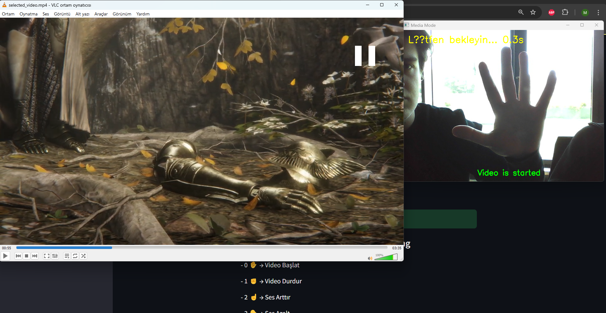
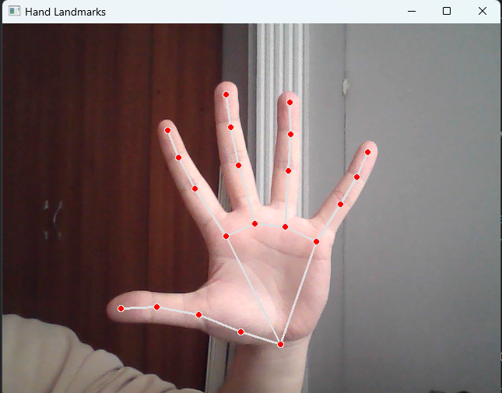
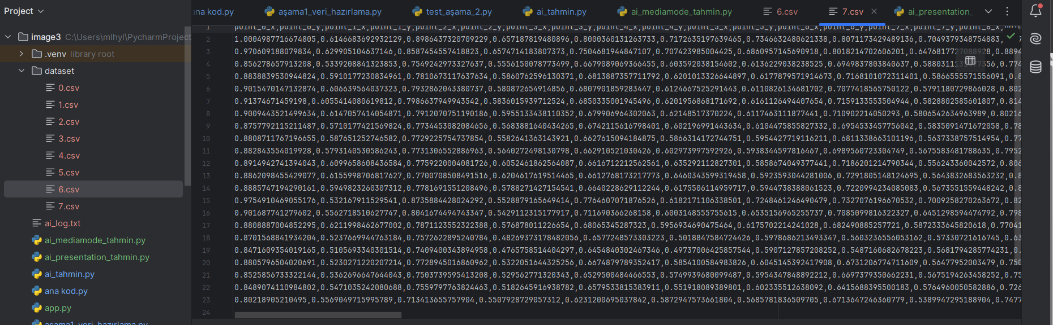
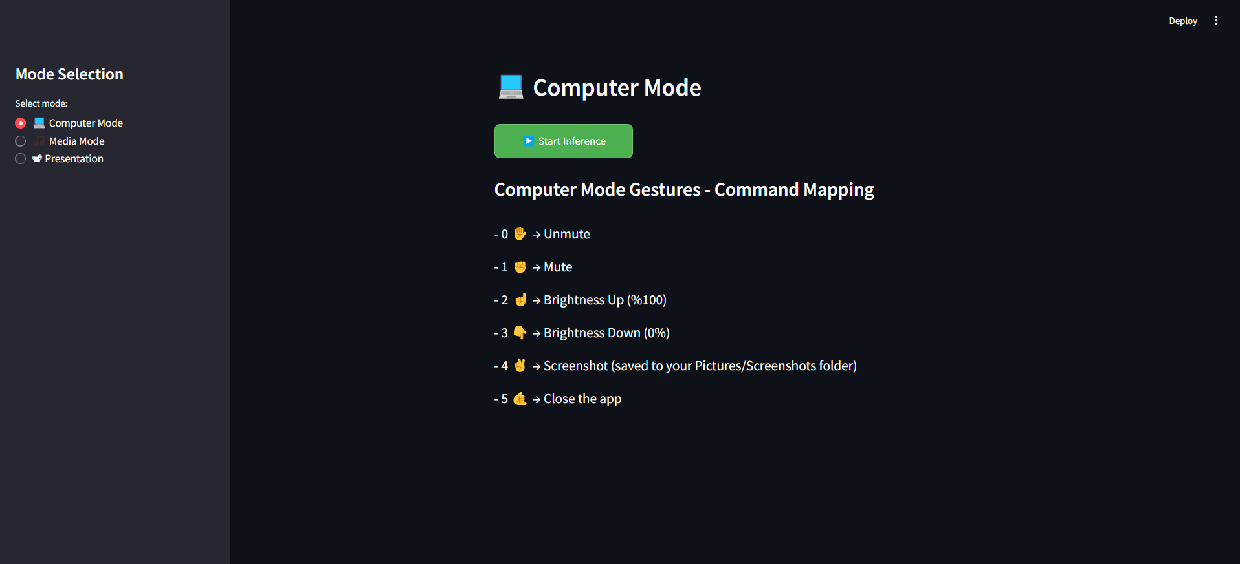
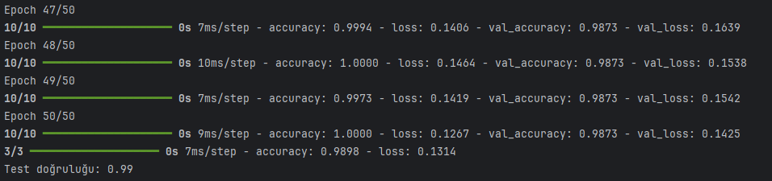
AI-Powered Hand Gesture Recognition Interface
Melih Yıldız, Hüseyin Murat Ünlü, Rıza Kemal Belli, Yunus Kılıç, Advisor: Fevzi Aytaç Durmaz
Faculty of Engineering and Natural Sciences, Istinye University, Istanbul, Turkiye
INTRODUCTION
In this project, we developed a real-time hand gesture recognition system powered by artificial intelligence. The system detects hand landmarks via webcam and classifies gestures using a machine learning model. The aim is to allow users to control media applications (e.g., play/pause, volume) without physical contact, enhancing accessibility and user interaction in smart environments.
METHODS
- A dataset of hand gestures was collected using the webcam and MediaPipe Hands framework
- Landmark coordinates (x, y, z) of 21 keypoints were extracted.
- Data was preprocessed, normalized, and split into training and test sets.
- A neural network model was trained using TensorFlow/Keras to classify gestures.
- The system was integrated with media control libraries for real-time interaction.
- A simple user interface was developed using Streamlit, allowing users to select video or presentation mode and control with hand gestures in real-time.
Fig.3. We started to video with this hand gesture in video mode.
RESULTS
- The system achieved over 95% accuracy in gesture classification.
- On-screen feedback was displayed upon gesture detection.
- System actions such as play/pause, volume up/down were triggered successfully.
- Challenges included lighting variations and hand position diversity.
- System was successfully implemented and tested across three different modes: Media Mode, Computer Mode, and Presentation Mode.
Fig.4. Mediapipe hand landmarks.
Fig.5. Our coordinate-based database.
CONCLUSION
Fig.1. System Interface
This study demonstrates the successful use of AI and computer vision for gesture-based media control. The system offers a contactless and intuitive interface, showing potential for smart home applications and assistive technologies. Future improvements may include multi-hand support, more gesture classes, and a mobile app version.
ACKNOWLEDGEMENTS
This project was developed as part of the AI coursework at Istinye University. We would like to thank our instructor for guidance and support.
REFERENCES
https://developers.google.com/mediapipe
https://www.tensorflow.org/
https://github.com/AndreMiras/pycaw
https://docs.opencv.org/
Fig.2.Dataset accuracy rate.
This research was supported by the financial support from TUBITAK-NIMAD bilateral grant, Project #121N158
For further questions, please contact nur.mustafaoglu@sabanciuniv.edu

